Slide 1

Healthy Blue 101

Slide 2

Agenda
Role of Provider Relations and Education
Your Role as a Participating Provider
How To Be a Self-Serving Provider
My Insurance Manager
My Remit Manager
Authorizations
Claim Submissions
Provider Disputes
Contacts and Resources

Slide 3
Role of Provider Relations and Education

Slide 4
How We Educate Providers By
Offering training and support.
Hosting webinars on various topics.
Providing newsletters and bulletins on different information.
Conducting annual workshops that include initiatives for the upcoming benefit year.

Slide 5
Your Role as a Participating Provider

Slide 6
Responsibilities of Participating Providers
Filing all claims for applicable members.
Accepting Healthy Blue’s payment plus any patient liability as full reimbursement.
Cooperating fully with the utilization review procedures.
Using other preferred providers for a member’s care unless medically necessary services, supplies or equipment are not available from a preferred provider, or in cases of medical emergency.
Being culturally competent provider which includes providing interpreter services.

Slide 7
Helpful Tips
Always ask for the member’s current identification (ID) card at each visit.
Always verify eligibility and benefits before rendering services.
Check the member’s cost-sharing before processing payment.
Submit all claims with the complete ID number, including the prefix.
Submit other payer liability details with the claims when applicable.

Slide 8
Being a Self-Serving Provider

Slide 9
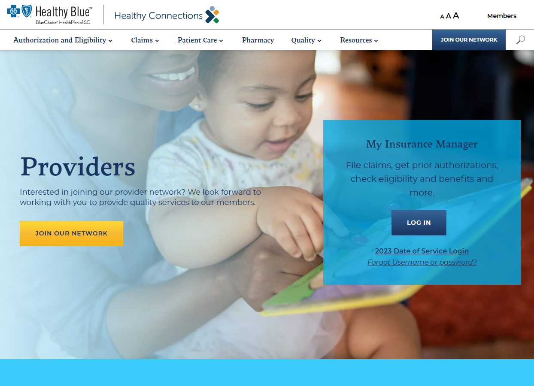
Healthy Blue Website
www.HealthyBlueSC.com
includes:
  Authorization and Eligibility
  Claims
  Patient Care
  Pharmacy
  Quality
  Resources

Slide 10

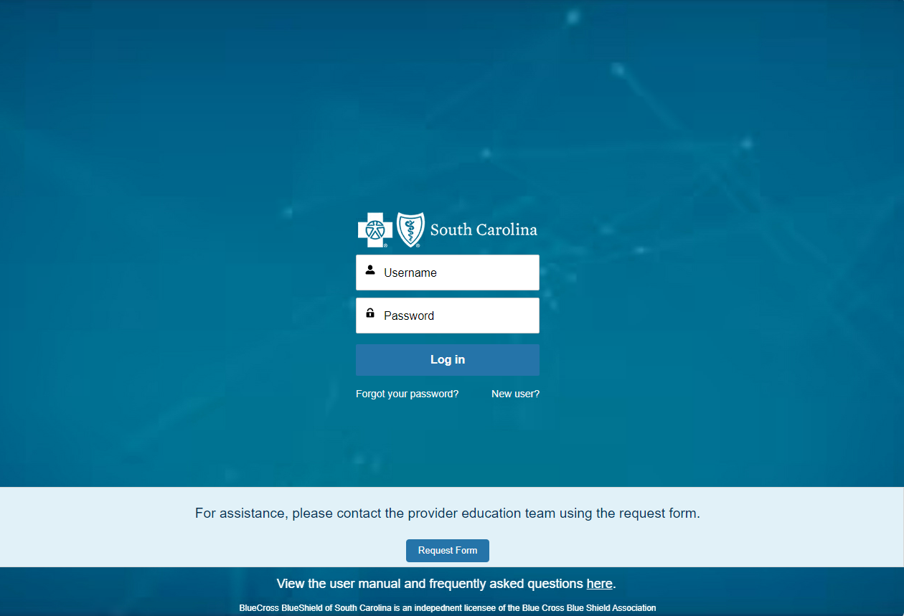
My Provider Enrollment Portal
My Provider Enrollment Portal
  Used for all provider enrollment process to include demographics, credentialing and more
  For participation in the Healthy Blue network, you must have your Medicaid ID number

Slide 11
My Insurance Manager
This is a web-based tool that gives providers quick and easy access to patient information.
You can log into MIM to:
Get eligibility and benefits.
Submit claim submissions.
Access claims status.
Request prior authorizations.
And much more.

Slide 12
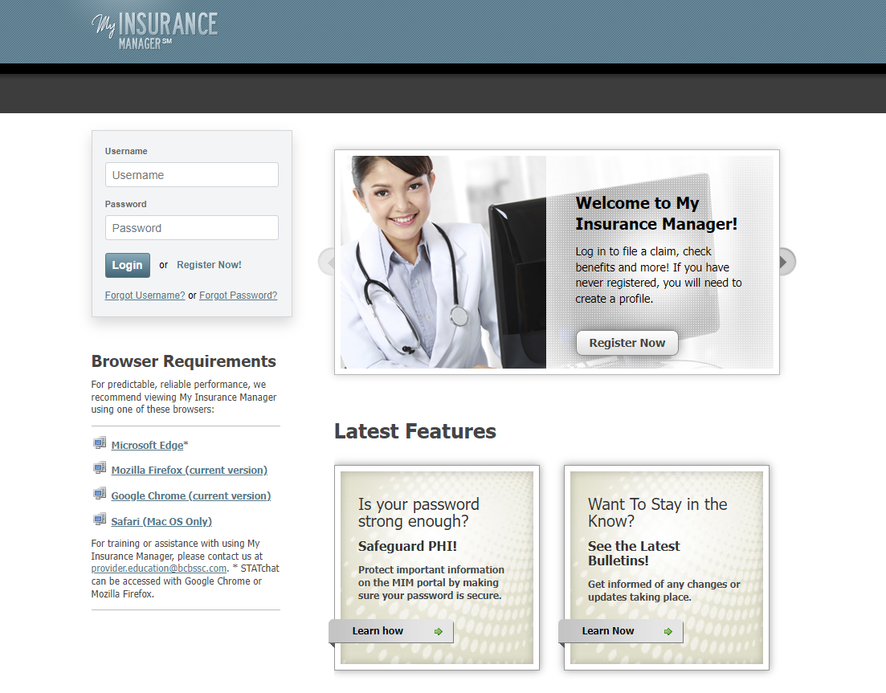
My Insurance Manager
Available Guides Include
Getting Started
Eligibility and Benefits
Claims Entry
Claims Status, Patient Directory, Superbill Maintenance and Coordination of Benefits
Precertification
Office Administration
Provider Validation: MD Checkup User Guide

Slide 13
My Remit Manager
Web-based tool used to track payments and pull electronic remittance advices.
Use My Remit Manager to:
View electronic remittance advices
View information categorized by check number or patient
Print individual remittances by patient or group
Not an enrolled provider with Healthy Blue? Begin the enrollment process today.

Slide 14
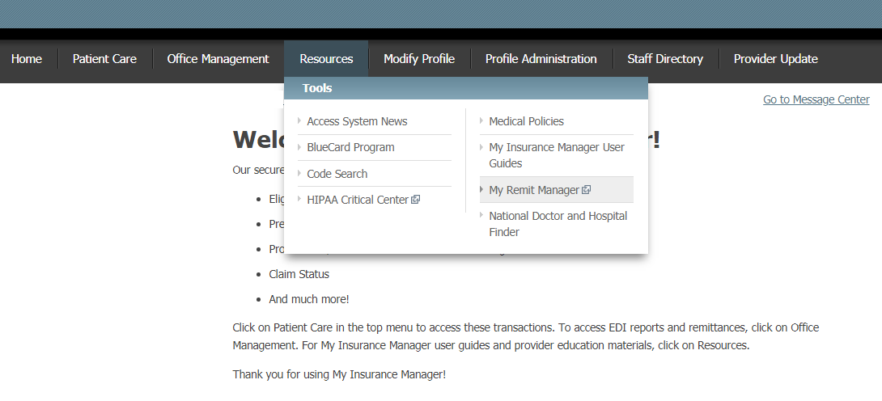
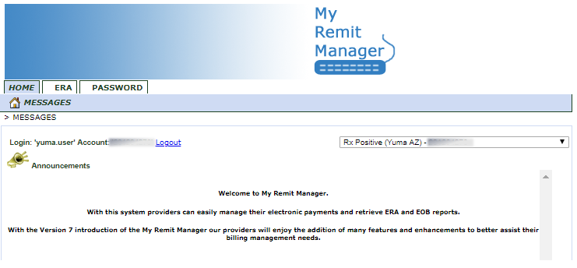
My Remit Manager
Options include:
Sort and view checks by the check date or posting date
Select the Adobe icon to view the Remit
Select the check number to view
  Members associated with the check
  Date of service
  Processed status (paid or denied)
  Amount billed and paid

Slide 15
Authorizations

Slide 16
Authorizations — Medical Services
Healthy Blue requires prior authorization for certain procedures and durable medical equipment. This process allows us to check ahead of time whether services meet criteria for coverage by a member’s health plan.
Methods:
Call Provider Service at 866-757-8286.
Use My Insurance Manager.
Use the Medical Forms Resource Center.

Slide 17
Authorizations — Behavioral Health Services
Healthy Blue requires prior authorization for certain mental health and substance use disorders.
Methods:
Call Companion Benefit Alternatives at 800-868-1032.
Fax to 803-870-6506.
Use My Insurance Manager.
Use the Forms Resource Center.

Slide 18
Claim Submissions

Slide 19
Claim Submissions
Timely filing for both electronic and paper claims submission is 365 days for original and corrected claims.
To submit claims, you can:
Use My Insurance Manager℠.
Submit through your clearinghouse.
Submit hard copy by mail to:
  Healthy Blue
  P.O. Box 100317
  Columbia, SC 29202-3317.
Reminder: The payer ID for Healthy Blue is 00403.

Slide 20
Provider Disputes

Slide 21
Provider Disputes
Must be submitted within 90 calendar days of the date of the Explanation of Payment.
Common reasons for submitting a provider dispute includes but not limited to:
Contractual payment issues
Disagreements over reduced or zero-paid claims
Post-service authorization issues
Other health insurance denial issues
Timely filing issues

Slide 22
Provider Disputes
Healthy Blue requires the following information when submitting a provider dispute:
Your name, address, phone number, email, and either your NPI or TIN
The member’s name and Healthy Blue Medicaid ID number
A listing of disputed claims, including the Healthy Blue claim number and the date(s) of service(s)
All supporting statements and documentation

Slide 23
Submitting Provider Disputes
Options include:
Email: HBProviderService@HealthyBlueSC.com
Fax: 803-870-6511
Call: Provider Service at 866-757-8286
Mail: Healthy Blue
  Provider Dispute Unit
  Mail Code: AX-570
  P.O. Box 100317
  Columbia, SC 29202-3317
Visit: In person at:
Healthy Blue
4101 Percival Road
Columbia, SC 29229
Providers>Claims>Provider Disputes

Slide 24
Contacts and Resources

Slide 25
Provider Service
Phone: 866-757-8286 or TTY: 866-773-9634
Fax: 803-870-6511
Hours: Monday – Friday, 8:30 a.m. to 5 p.m. EST
  Disease Management (DM) Department
Phone: 866-757-8286 or TTY: 866-773-9634
Fax: 803-870-6502
Hours: Monday – Friday, 8:30 a.m. to 5 p.m. EST
Utilization Management (UM) Department
Phone: 866-757-8286 or TTY: 866-773-9634
Fax: 803-870-6500
Hours: Monday – Friday, 8:30 a.m. to 5 p.m. EST
24/7 Nurse line
Phone: 800-830-1525
Vision Service Plan* (VSP)
Phone: 800-615-1883
Hours: Monday – Friday, 8 a.m. to 5 p.m. EST
Saturday, 10 a.m. to 3 p.m. EST
Sunday, 10 a.m. to 4 p.m. EST
Website: www.vsp.com
Case Management (CM) Department
Phone: 866-757-8286 or TTY: 866-773-9634
Fax: 803-870-6501
Hours: Monday – Friday, 8:30 a.m. to 5 p.m. EST
Behavioral Health
Phone: 800-868-1032
Fax: 803-870-6506
Hours: Monday – Friday, 8:30 a.m. to 5 p.m. EST
Evolent*
  Phone: 888-642-9181
  Hours: Monday – Friday, 8 a.m. to 5 p.m. EST
  Website: www.RadMD.com
* These are independent companies that manage services on behalf of BlueChoice HealthPlan.

Slide 26
CarelonRx — Prior Authorizations
Retail
Phone: 844-410-6890
Fax: 844-512-9005
Hours: Monday- Friday 8 a.m. to 8 p.m. EST
Saturday 10 a.m. to 2 p.m. EST
Home Delivery/Mail Order
Phone (24/7): 833-203-1737
Fax: 800-207-3118
Medical Injectables
Phone: 833-988-1264
Fax: 844-512-7027
Hours: 7 a.m. to 7 p.m. EST
Specialty Pharmacy
Phone (24/7): 833-255-0646
Fax: 833-263-2871
Novologix – Prior Authorizations
Phone: 844-345-2803
Fax: 866-494-9927
Hours: Monday- Friday 9 a.m. to 7 p.m. EST
Avalon Healthcare Solutions
Phone: 844-227-5769
Fax: 813-751-3760
Website: PAS Portal

Slide 27

BlueBlast
A monthly newsletter that includes:
  Important health plan updates.
  Healthy Connections updates.
  Announcements.
  Billing and claims information.
  And much more!
Visit www.HealthyBlueSC.com to sign up.

Slide 28
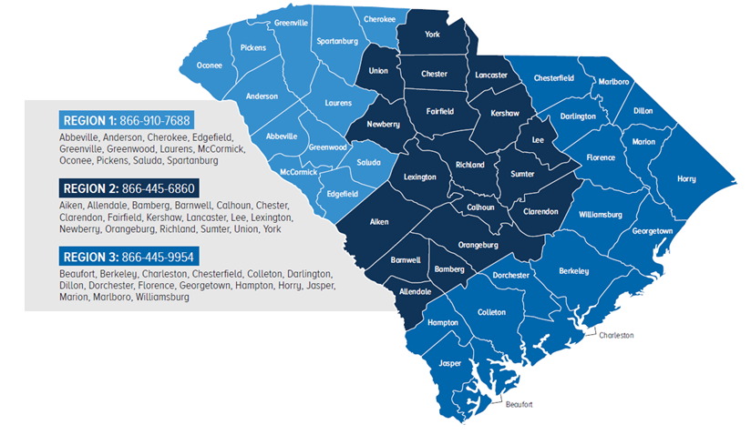
Modivcare
Service line available Monday – Friday from 8 a.m. to 5 p.m., EST
Call at least three business days before the appointment
Read more information online.
Modivcare is an independent company providing transportation services on behalf of BlueChoice® HealthPlan.

Slide 29
Healthy Blue Benefit Manuals
Visit www.scdhhs.gov/provider-manual-list *
  Manuals are listed by service type.
  Includes general information, billing details, claims filing information and much more.
* This link leads to a third-party site. Their organization is solely responsible for the content and privacy policies on the site.

Slide 30
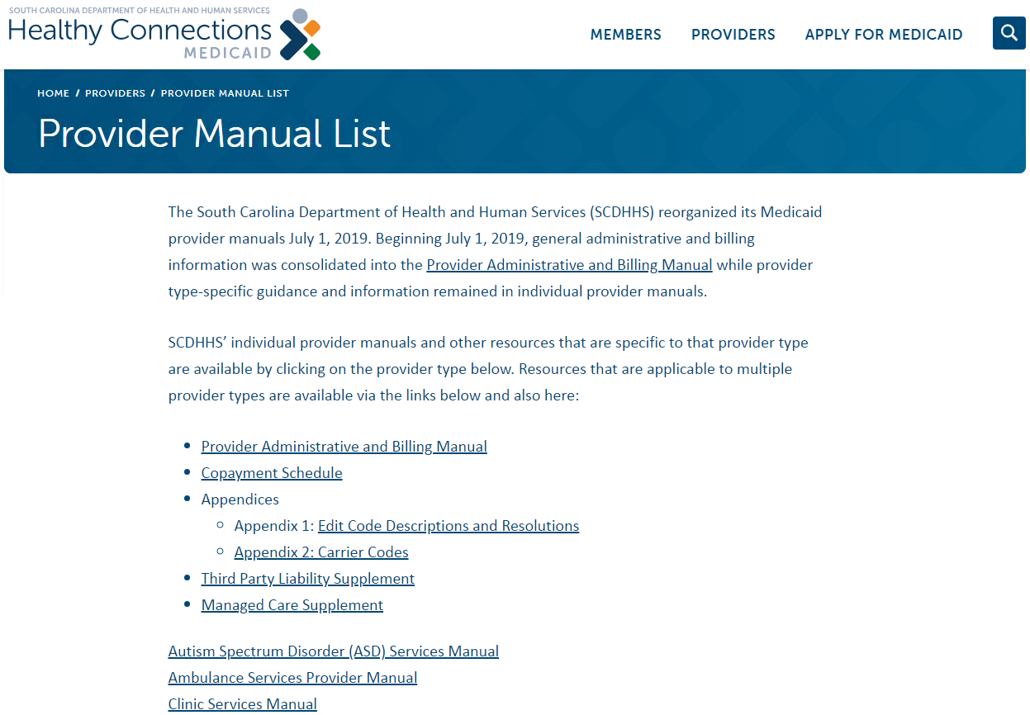
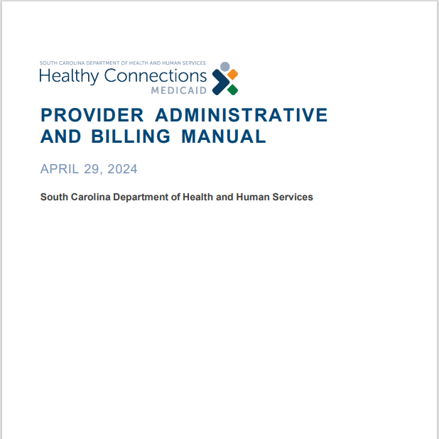
Example of a Benefit Manual

Slide 31
Verifying Covered Services
Visit www.scdhhs.gov/resource/fee-schedules *
  Information is listed by provider specialty.
  If the code is on the SCDHHS fee schedule, it is covered.
  Medicaid Manage Care Organization plans are required to offer at a minimum, the same benefits as Healthy Connections Fee for Service.
* This link leads to a third-party site. Their organization is solely responsible for the content and privacy policies on the site.

Slide 32
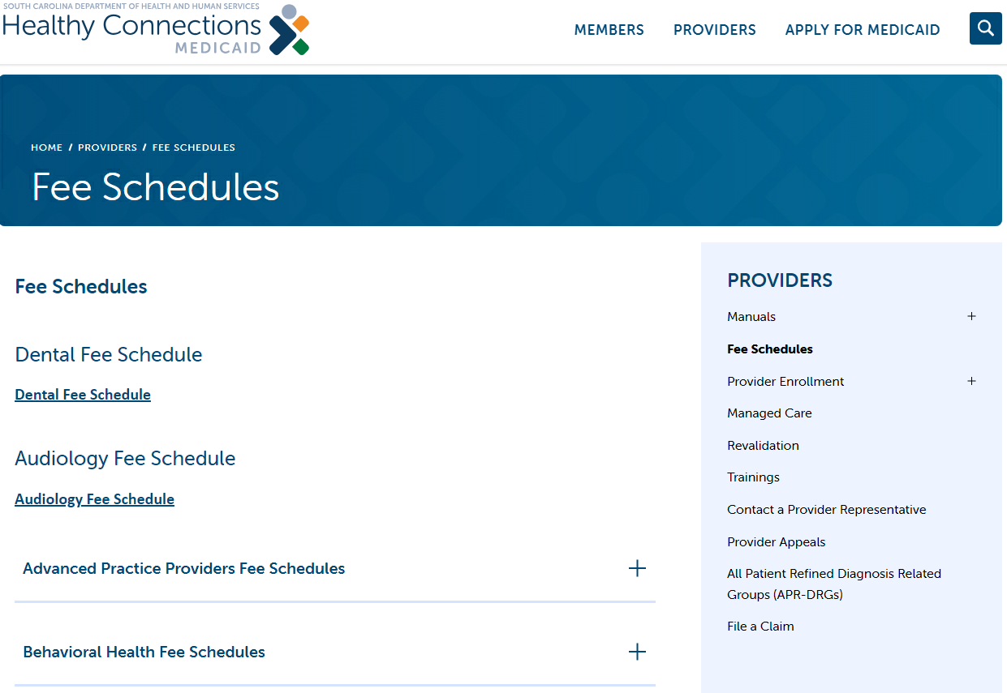
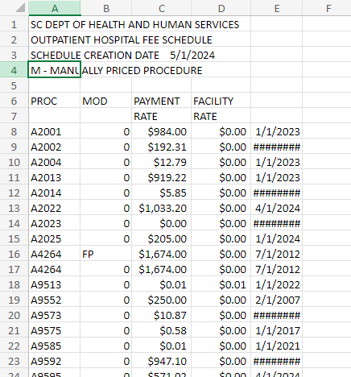
Example of Fee Schedule

Slide 33
Healthy Blue Territory Map
Greenville
Spartanburg
Cherokee
York
Pickens
Inga Rearden
Inga.Rearden@bluechoicesc.com
(803) 264-9523
Oconee
Chester
Lancaster
Anderson
Union
Chesterfield
Marlboro
Laurens
Fairfield
Dillon
Newberry
Kershaw
Darlington
Michaelyn Jefferson
Michaelyn.Jefferson@bcbssc.com
(803) 264-1482
Abbeville
Greenwood
Lee
Marion
Saluda
Richland
Florence
McCormick
Lexington
Sumter
Horry
Edgefield
Calhoun
Patricia Thompson
Patricia.Thompson@bcbssc.com
(803) 264-5311
Aiken
Clarendon
Williamsburg
Orangeburg
Georgetown
Barnwell
Bamberg
Berkeley
Jessica Ballard
Jessica.Ballard@bcbssc.com
(803) 382-5154
Dorchester
Allendale
Fancy Crayton – Entire State
CIMS/FQHCs
Fancy.Crayton@bluechoicesc.com
(803) 264-3196
Hampton
Colleton
Cynthia Brown
Cynthia.Brown@bcbssc.com
(803) 264-8497
Charleston
Jasper
Beaufort
Providers>Resources>Contact Us

Slide 34
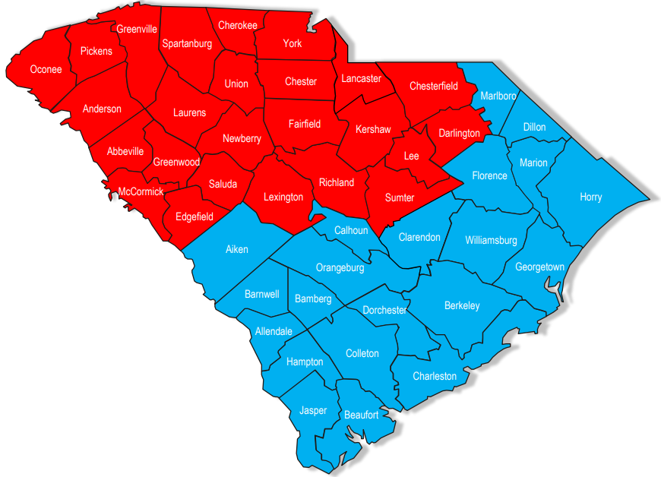
Behavioral Territory Map
Romona Williams
Romona.Williams@bcbssc.com
(803) 382-5282
Bridgette Honor
Bridgette.Honor@bcbssc.com
(803) 264-5585
Providers>Resources>Contact Us

Slide 35


